Slide 1
1. Let Me Entertain You Quiz

Slide 2
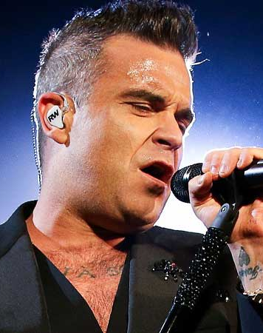
1. Who performed this song? A) Robbie Williams B) Serena Williams
This Photo by Unknown Author is licensed under CC BY

Slide 3
2. When was the song released? A) 1998 B) 1988
This Photo by Unknown Author is licensed under CC BY

Slide 4
3. Which British Boy Band did he once sing in? A) Take 5 B) Take That

Slide 5
Answers
1 A Robbie Williams
2 B 1998
3 B Take That

