Slide 1
1. Let Me Entertain You

Slide 2
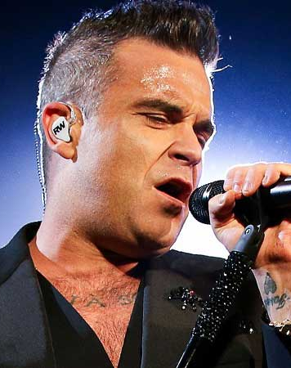
Robbie Williams
This Photo by Unknown Author is licensed under CC BY

Slide 3
1998
This Photo by Unknown Author is licensed under CC BY

Slide 4
Solo Singer
This Photo by Unknown Author is licensed under CC BY

Slide 5
Robbie Williams once sang in this British boy band
This Photo by Unknown Author is licensed under CC BY-NC-ND

