Slide 1
3. Come Together

Slide 2
This song encourages us to work together for a better future

Slide 3
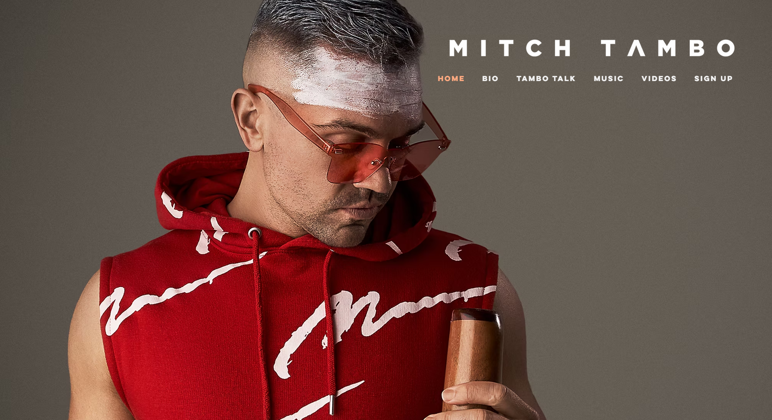
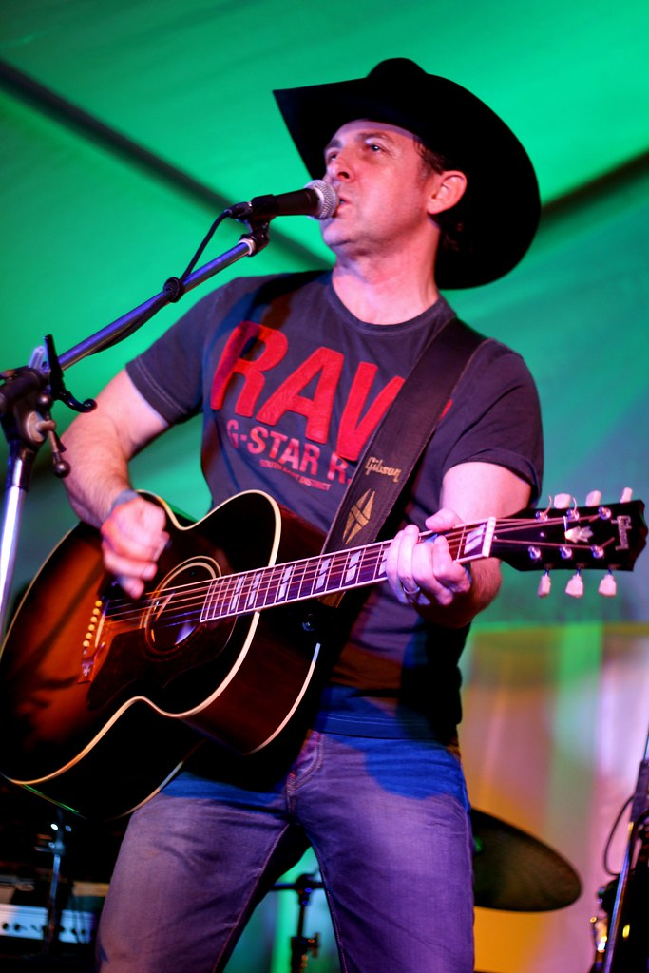
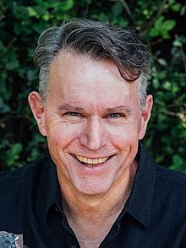
Collaboration – working together
Isaiah Firebrace-
Eurovision 2017 Grand Finalist
Mitch Tambo
Australia Decides’ Artist
Lee Kernaghan
Australian Country Singer
Colin Buchanan
Australian Country
Singer
This Photo by Unknown Author is licensed under CC BY-NC
This Photo by Unknown Author is licensed under CC BY-SA

Slide 4
2022

Slide 5
* Wurundjeri people (Yarra Valley region of Melbourne) * Bunjil created the land * “On the wings of mighty Bunjil we will rise”
This Photo by Unknown Author is licensed under CC BY

