Slide 1
Dance Craze Crazy
Old Music, New Life: 2005

Slide 2
Bill Haley
This Photo by Unknown Author is licensed under CC BY-NC

Slide 3
1955

Slide 4
Elvis the Pelvis (Elvis Presley)
This Photo by Unknown Author is licensed under CC BY-SA

Slide 5
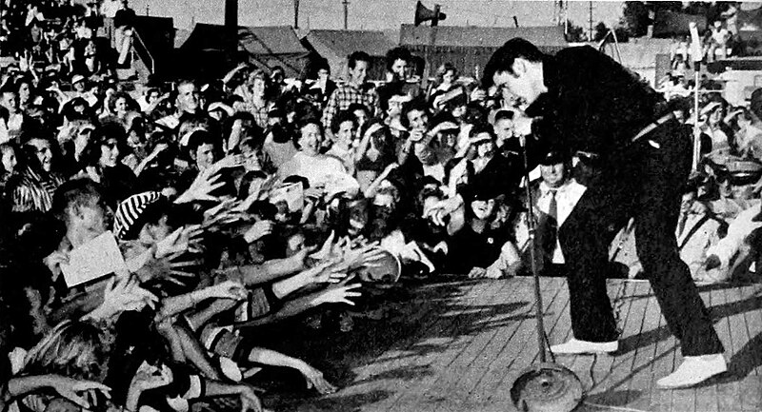
made the girls all scream and cry
This Photo by Unknown Author is licensed under CC BY-SA-NC
This Photo by Unknown Author is licensed under CC BY-SA

Slide 6
The Twist
This Photo by Unknown Author is licensed under CC BY-NC-ND

Slide 7
The Mashed Potato
This Photo by Unknown Author is licensed under CC BY-NC-ND

Slide 8
That’s rock ‘n’ roll

Slide 9
The Beatles 1962 mop-top hair

Slide 10
Love Me Do
This Photo by Unknown Author is licensed under CC BY-SA-NC

Slide 12
Back beat drums

Slide 13
Electric guitars

Slide 14
Go-go girls
This Photo by Unknown Author is licensed under CC BY-SA

Slide 15
Martin Luther King 1963

