Slide 1
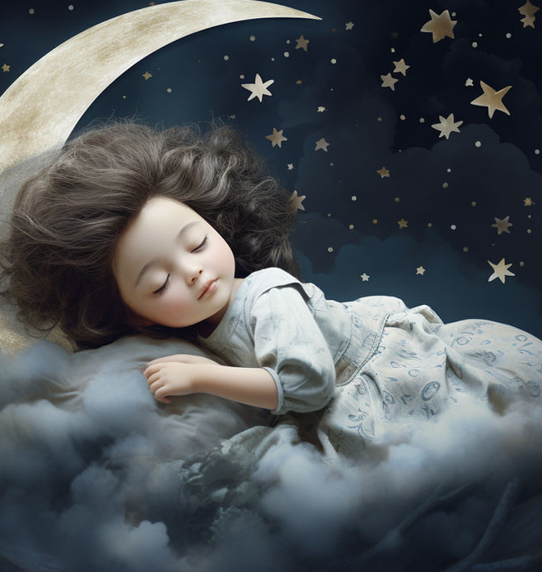
Lunar Lullaby

Slide 2
Kathleen Nicely
Author of poem
Music by Jacob Narverud

Slide 3
What is a lullaby?

Slide 4
Lunar Celestial Radiant

Slide 5
Describes watching a sleeping child under the moon and stars

Slide 6
Sees the child as celestial (relating to the sky) and not of the earth

Slide 7
The moon and north star gaze upon the sleeping child’s face

Slide 8
When the child dreams they return to the stars

Slide 9
What instrument/s will be used at the performance for this song?

Slide 10
What image will you have in your mind as you sing this song?

Slide 11
What can we learn from this performance?

