Slide 1
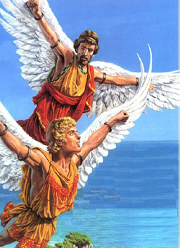
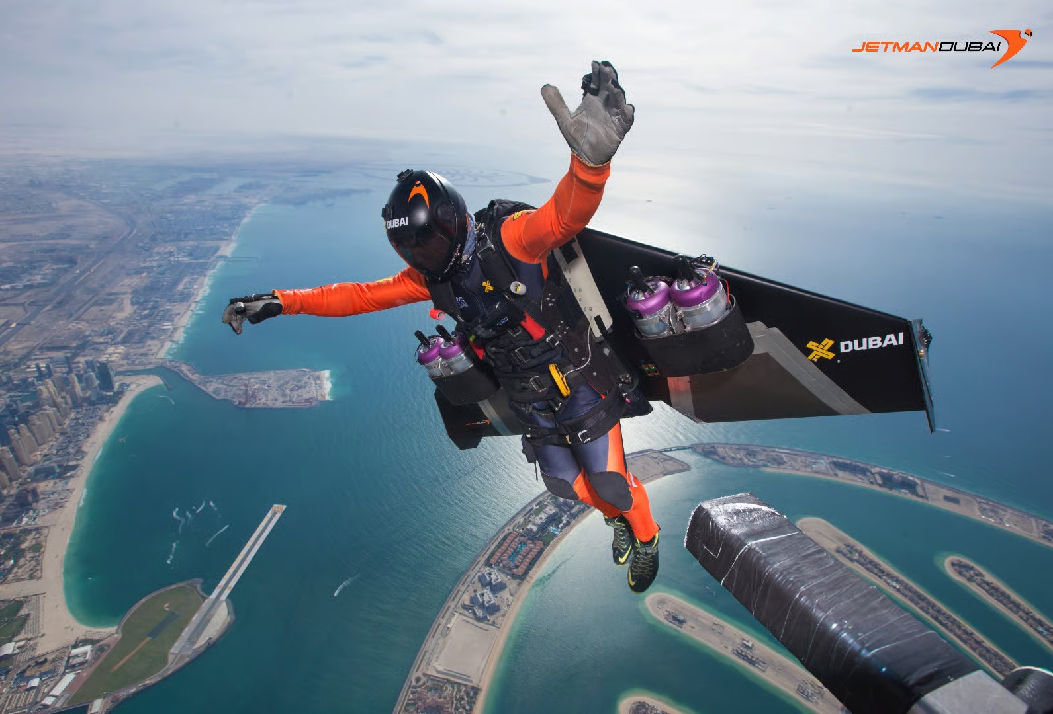
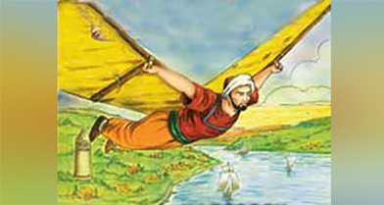
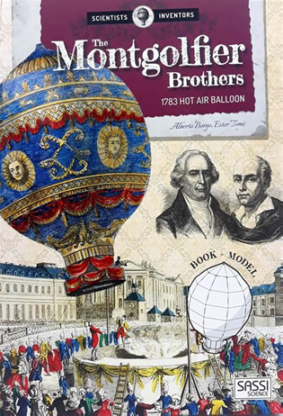
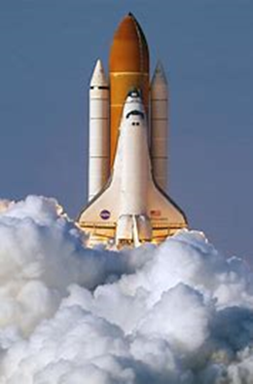
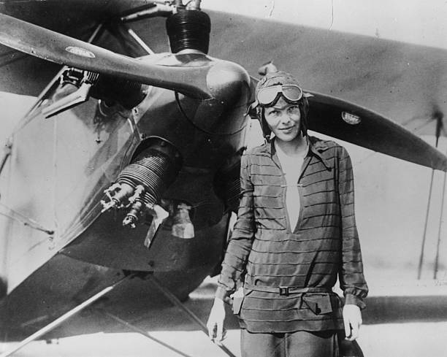
JETMAN
TAKE TO THE SKY

Slide 2
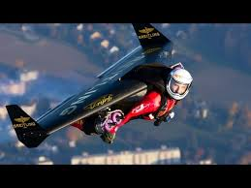
JETMAN – YVES ROSSY

Slide 3
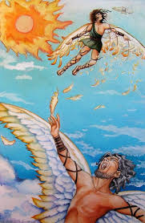
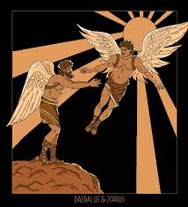
DAEDALUS
WINGS OF
FEATHERS
AND WAX

Slide 4
YUAN HUANG TOU
FLIES ON A KITE

Slide 5
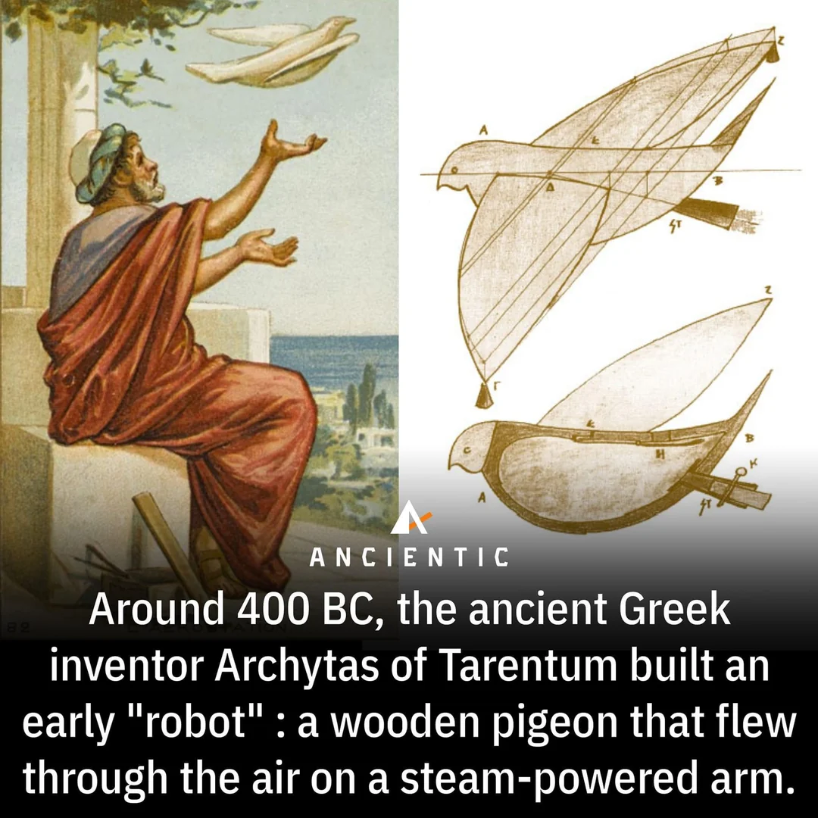
ARCHYTAS THE GREEK
A STEAM POWERED BIRD

Slide 6
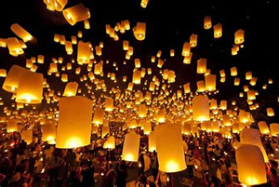
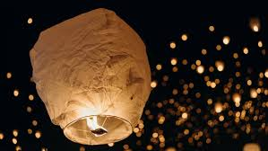
CHINA SKY LANTERN
CHINA MASTERS THE SKY LANTERN

Slide 7
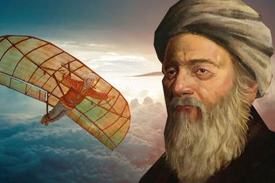
ABBAS IBN FURNAS
FLIES FASTER THAN A PHOENIX

Slide 8
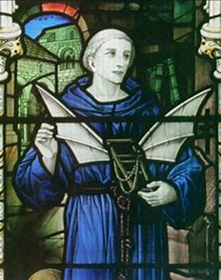
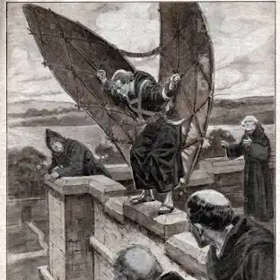
EILMER OF MALMESBURY BENEDICTINE MONK
GLIDES WITH WINGS FROM THE TOWER ABOVE

Slide 9
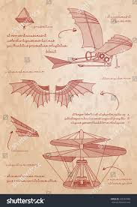
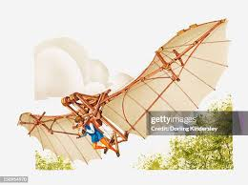
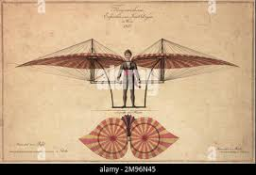
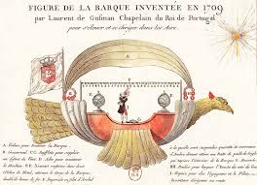
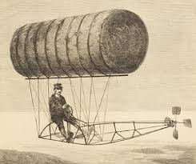
ITALY, SPAIN AND THE PORTUGUESE,
ELABORATE DESIGNS OF FLYING MACHINES

Slide 10
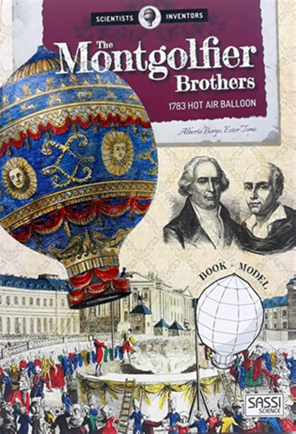
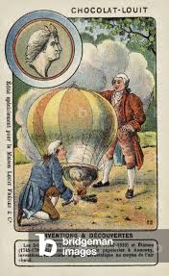
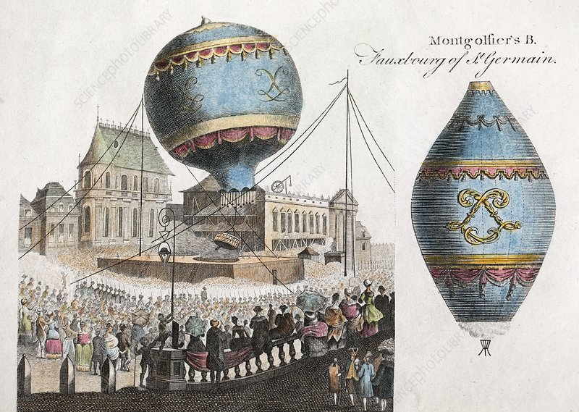
BROTHERS MONTGOLFIER
HOT BALLOON

Slide 11
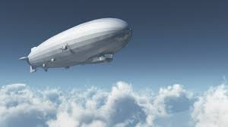
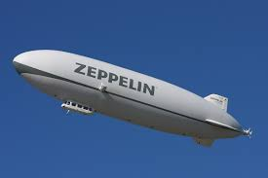
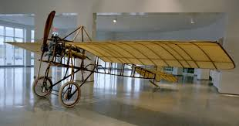
AIRSHIP, MONOPLANE………
MIGHTY ZEPPELIN

Slide 12
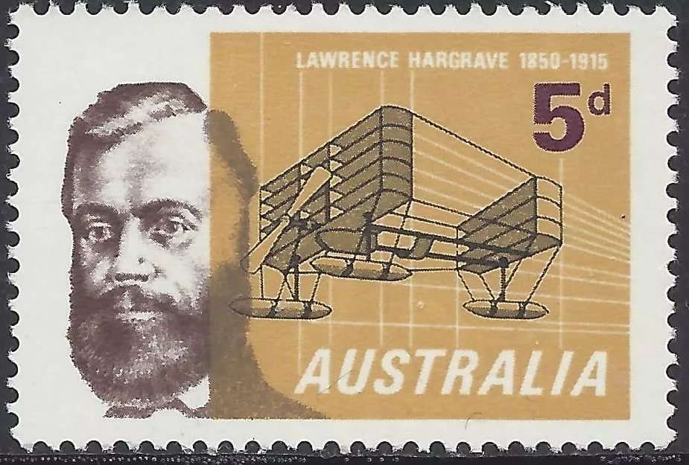
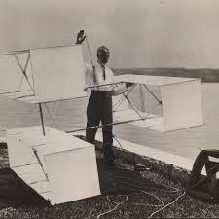
LAWRENCE HARGRAVE

Slide 13
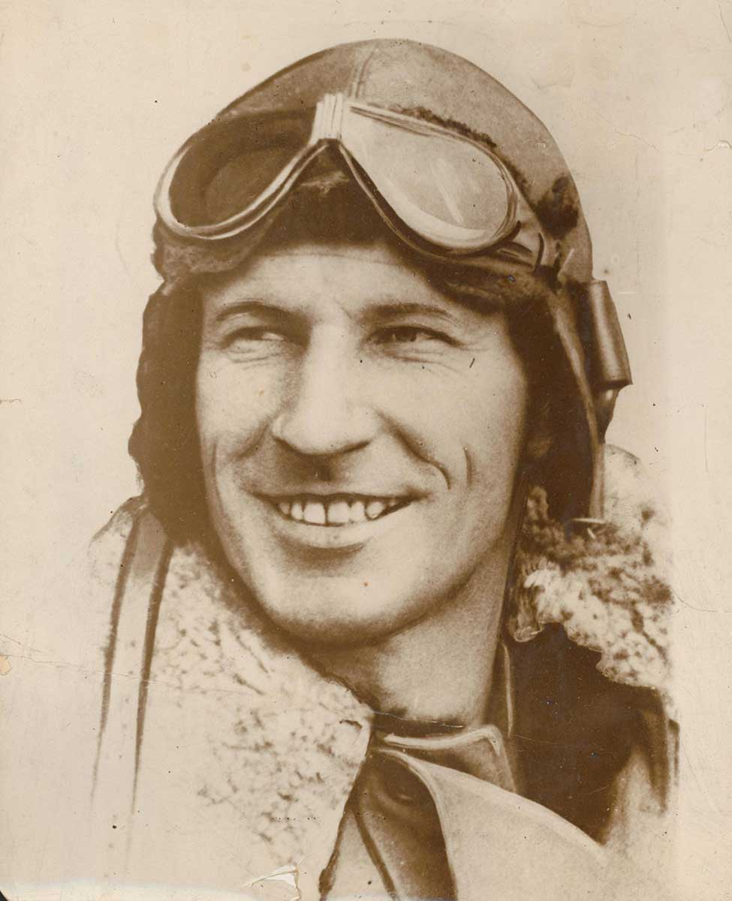
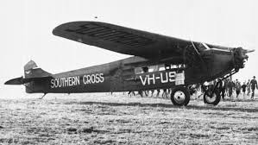
CHARLES KINGSFORD SMITH
AUSTRALIAN AVIATOR

Slide 14
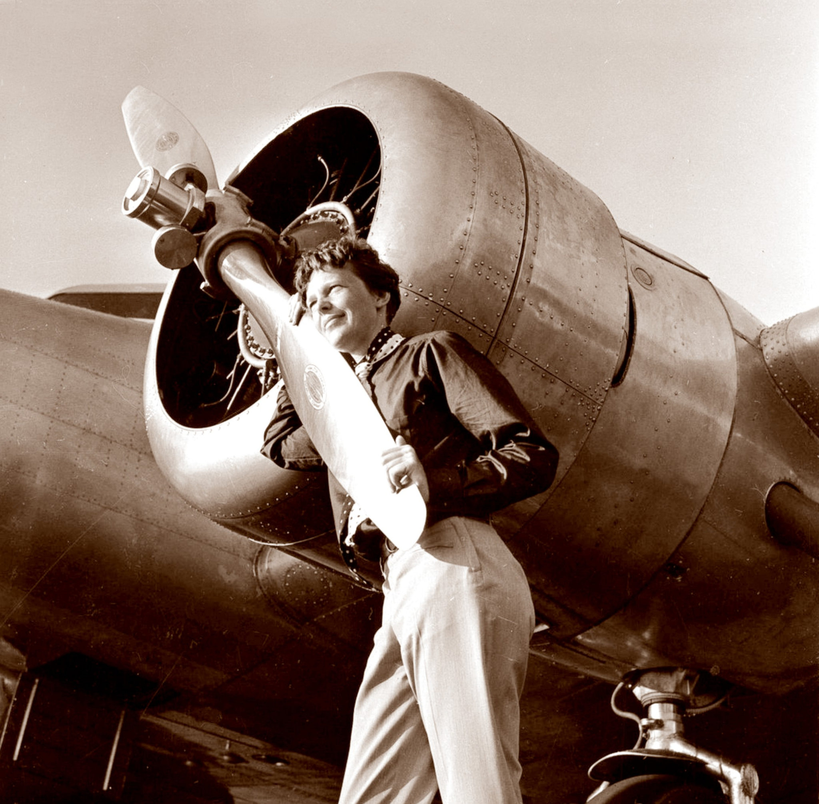
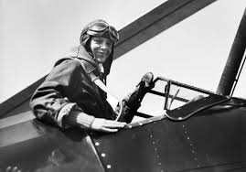
AMELIA EARHART
LIGHTING UP THE JET STREAM..

Slide 15
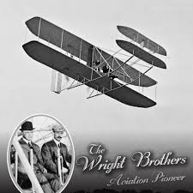
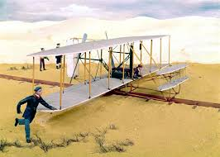
BROTHERS WRIGHT
SUSTAIN A FLIGHT…

Slide 16
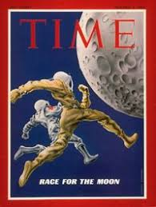
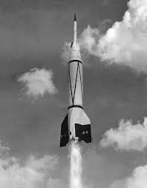
WE RACE TOWARDS THE MOON…

