Slide 1
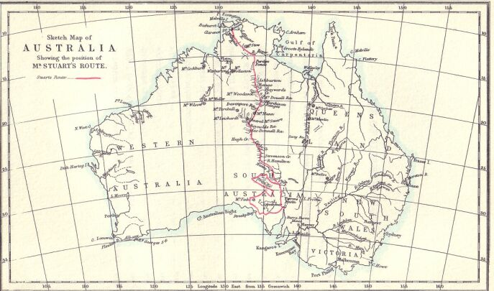
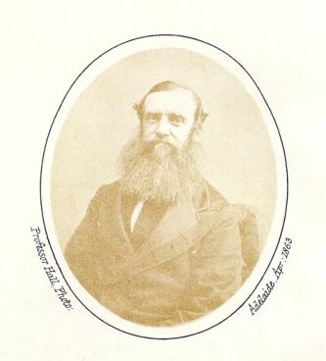
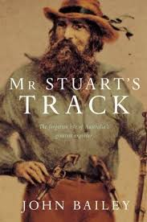
John McDouall Stuart

Slide 2
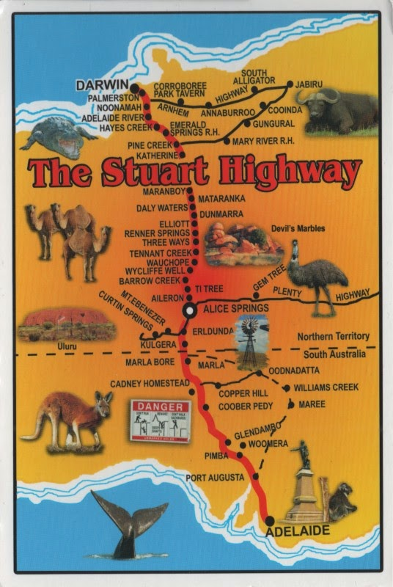
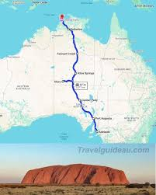
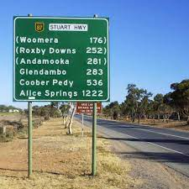
John McDouall Stuart is memorialised in the name of the main highway from Port Augusta to Darwin.

Slide 3
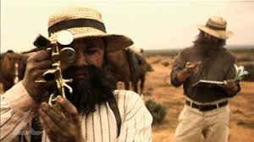
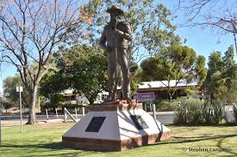
The crossing didn’t come easily though – he had several failed attempts before finally completing the journey in 1862, nearly blind and very sick. He died less than four years later.

Slide 4
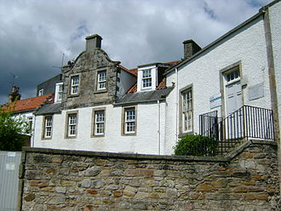
Stuart was born on 7 September 1815 in Scotland. He came to South Australia in 1839, joining the surveying department.
In 1844 he accompanied Charles Sturt on his 17-month expedition to the centre of the continent.

Slide 5
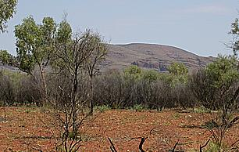
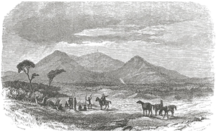
In 1858, he and two others explored beyond Lake Torrens and Lake Gairdner all the way to the site of Tennant Creek, grossly underestimating the provisions they needed and fortunate to make it back with lame horses and almost no water. He was widely celebrated as having almost crossed the interior, as his furthest point north was only 300 kilometres south of previously explored areas.

Slide 6
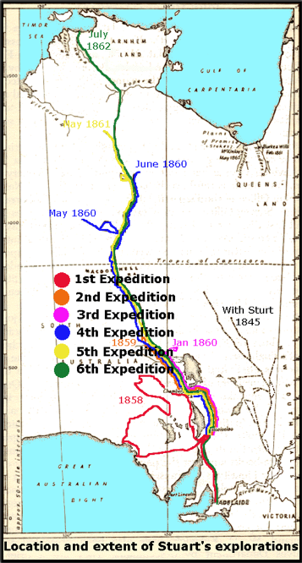
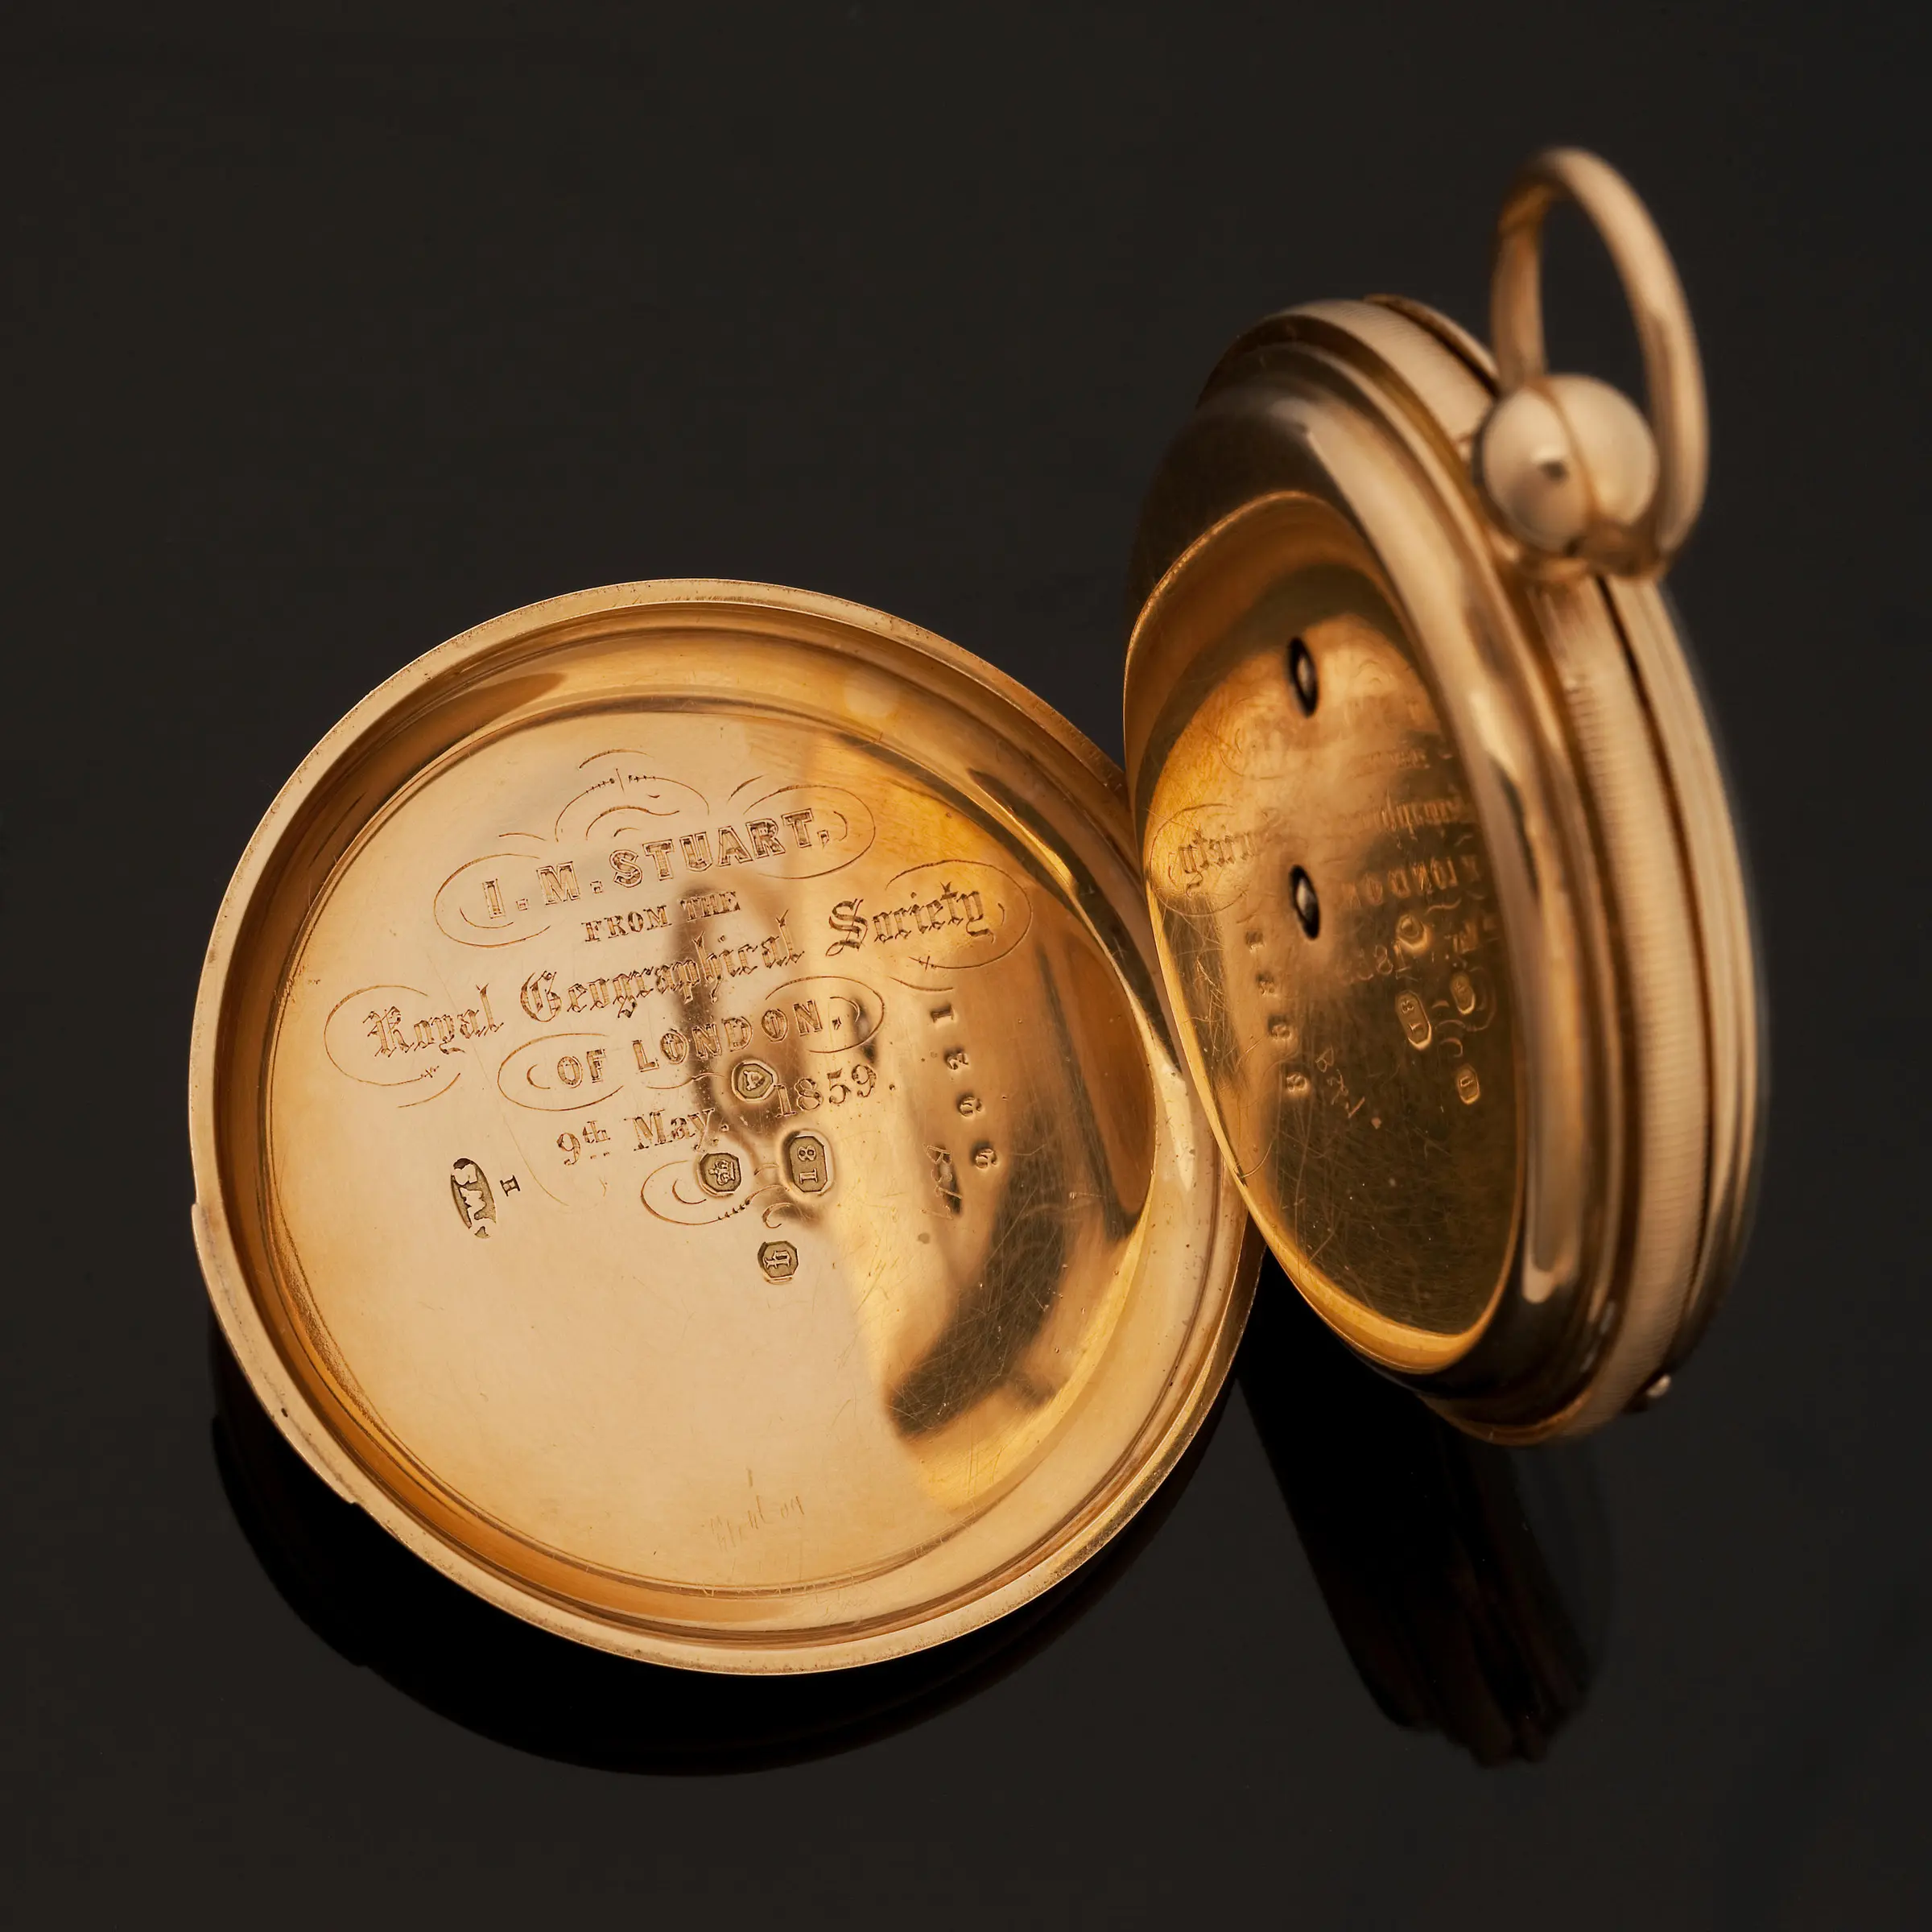
The following year he twice set out into the vast interior, discovering springs, and large plains covered in grass and saltbush, and continuing to find a good route north. In the Davenport Range, near Tennant Creek, he found signs of gold.
John McDouall Stuart Explorer's pocket watch, circa 1859

Slide 7
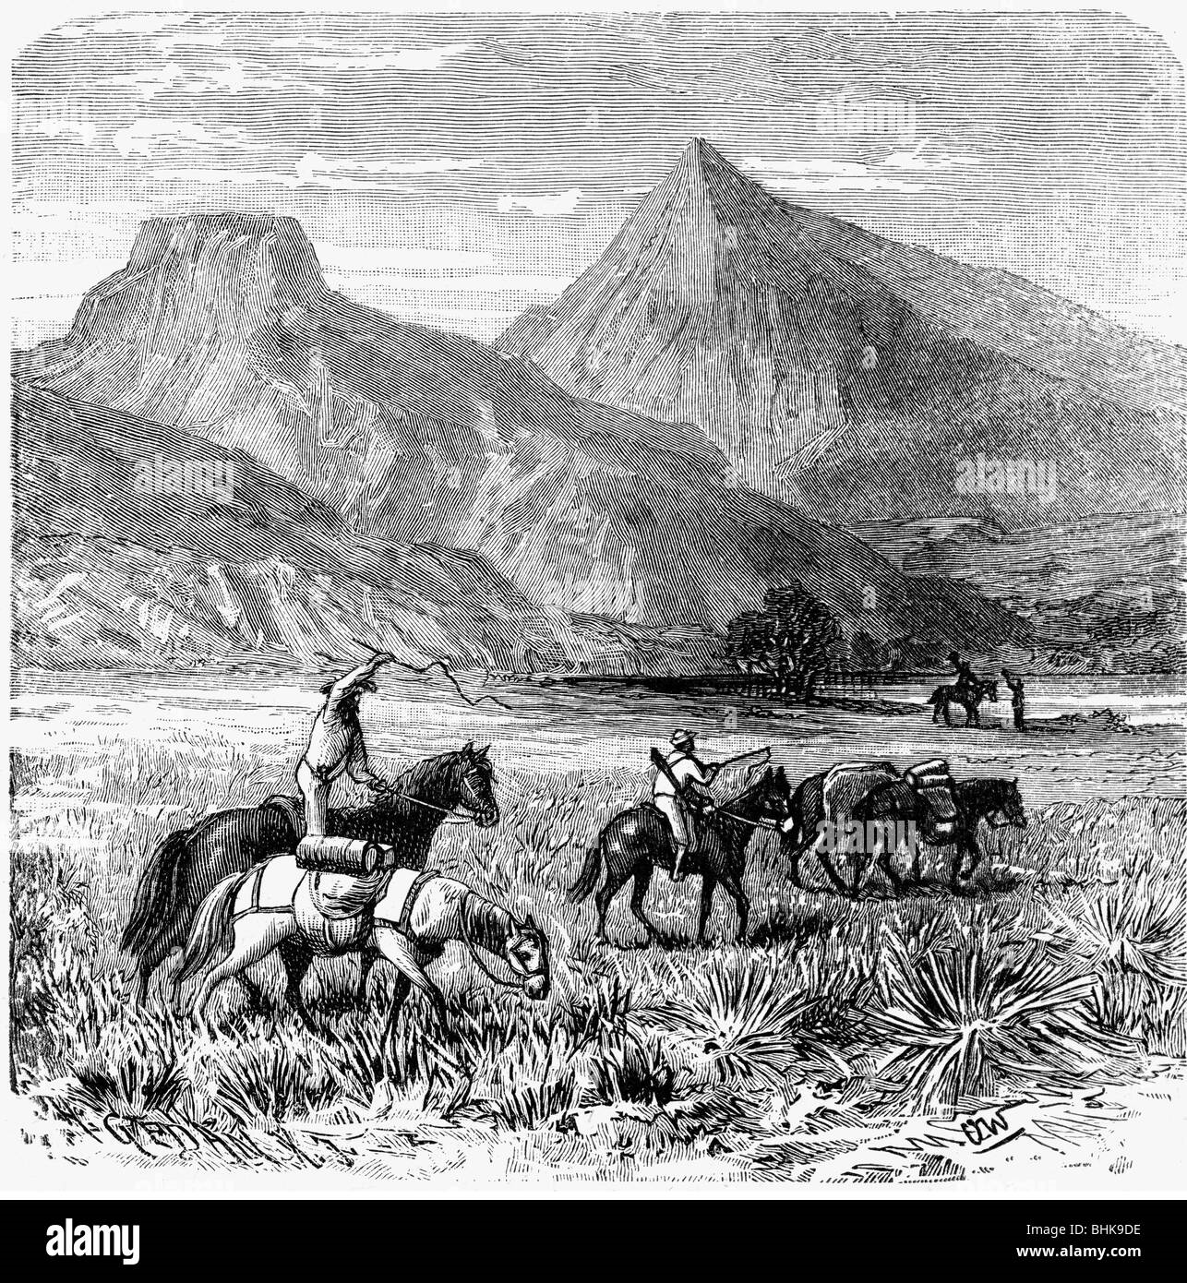
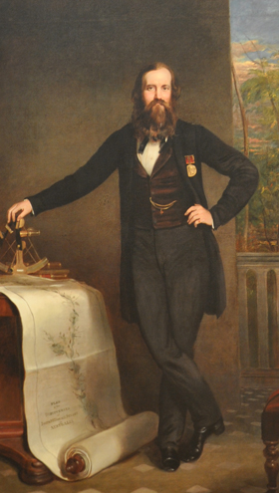

Slide 8
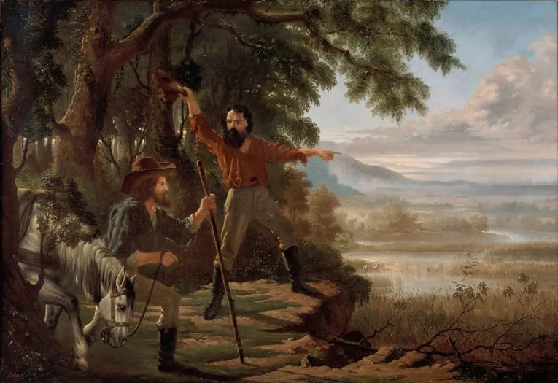
In 1860 he made his most serious attempt to cross the continent, but by the time he reached the Finke River, the party was suffering from scurvy and Stuart had lost the sight of his right eye.

Slide 9
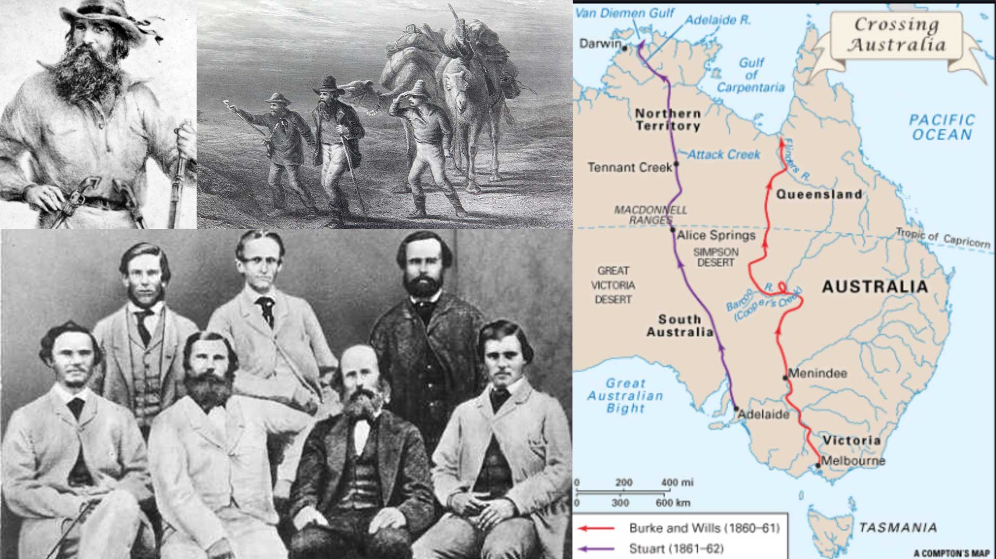

Slide 10
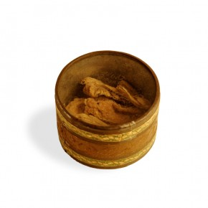
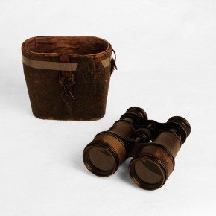
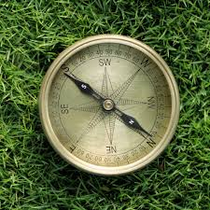
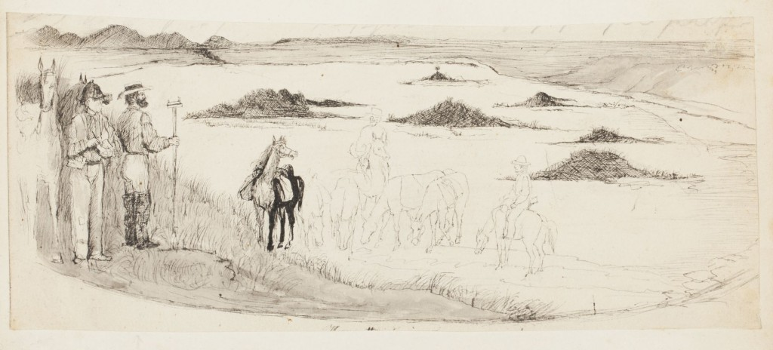
Another attempt in January 1861 was stopped by thick scrub and a shortage of rations, but in October that year his party set out yet again. They eventually reached the north coast on 24 July 1862. By then, the men were sick with scurvy, many of the horses were so weak they had to be left behind, and Stuart himself had to be carried on a stretcher.

Slide 11
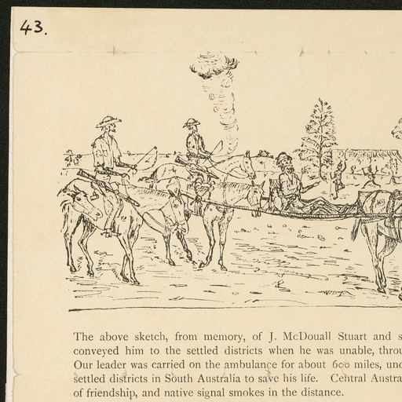

Slide 12
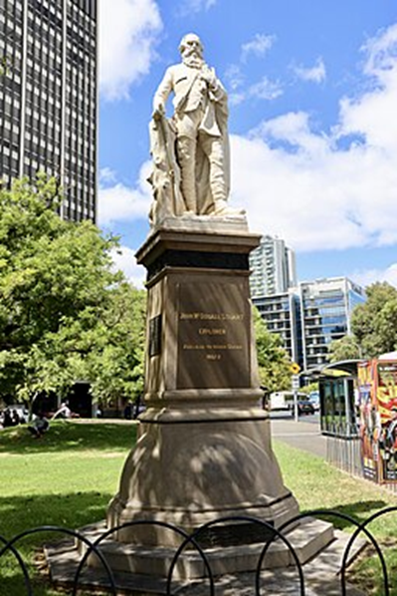
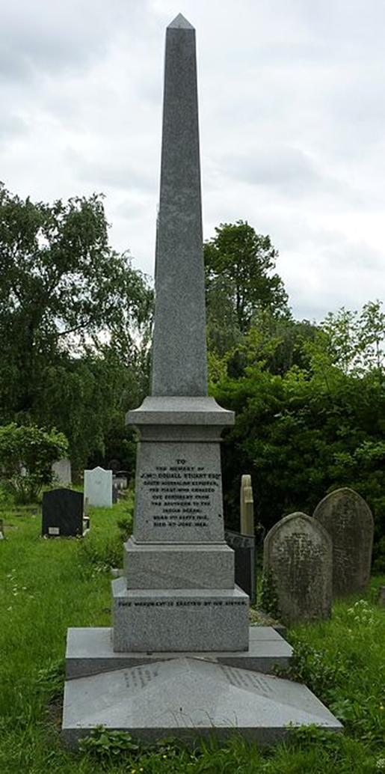
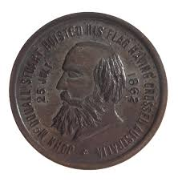
Despite these hardships, not one person was ever lost on any of the expeditions he led. John McDouall Stuart arrived back in Adelaide in December and was treated as a hero, having finally achieved the complete crossing that had eluded him for so long.

Slide 13
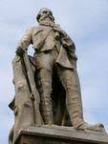
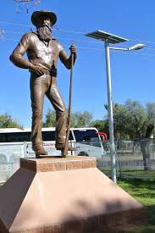
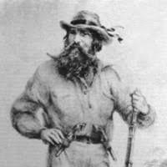
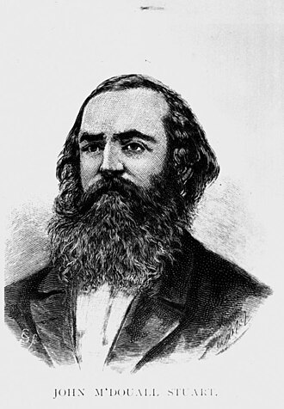
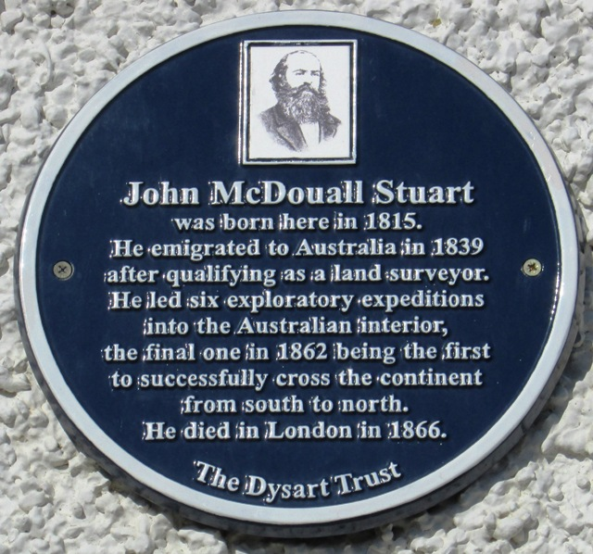
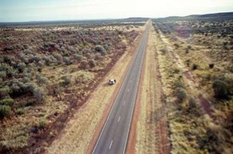

Slide 14
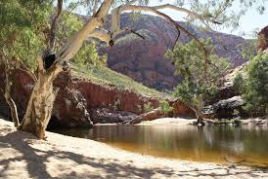
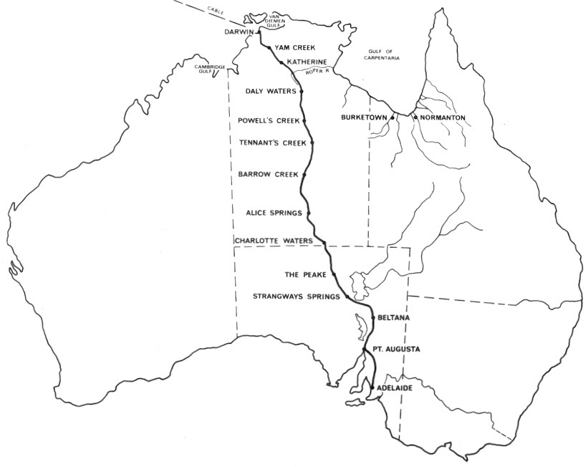
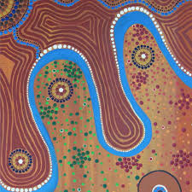
Water sources known to Aboriginal people largely determined the route of the Overland Telegraph Line through the dry interior of Australia and, two decades later, the Central Australia Railway.

